Slide 1
Multiplication and Division Operation Sense
Sit in groups of 3-4
Reading today: Van de Walle, et al (Ch. 8, part 2)
Notes:
Welcome. Sit in groups of 3-4. Today covers 2nd-3rd grade standards vertical articulation and multiplication/division problem structures. Reading: VdW Ch. 9 (old edition), pp. 203-211 on multiplicative problem structures.

Slide 2
Agenda
Quick follow ups
Vertical Articulation of Standards, 2nd and 3rd grade
Multiplication & Division Problem Structures, first pass
Multiplication & Division Problem Structures, second pass

Slide 3
Semantic vs Calculation Equations & Process Standards
Lexie, Allie, and Olivia have some stickers. They buy 25 more stickers. Now they have 40 stickers. How many stickers did they start with?
Semantic equation: __ + 25 = 40 (means follows the story)
Calculation equation: 40 – 25 = __ (means can be calculated this way)
Post Process Standards

Slide 4
Vertical Articulation: Grade 2-3
Round 1: Number Sense in grades 2-3
In your group, read the Number Sense strand of the grade 2-3 vertical articulation documents (Canvas).
On the Unit 3 Packet, p. 15:
Identify main ideas across grades 2-3.
What is NEW in 3rd grade? What is gone from 2nd grade? What skills are assumed to have been learned in 2nd grade?
Note standards that you do not understand.

Slide 5
Vertical Articulation: Grade 2-3
Round 2: Computation & Algebraic Thinking
Read the section of the vertical articulation document for Computation & Algebraic Thinking
On the Unit 3 Packet, p. 16:
Identify main ideas across grades 2-3.
What is NEW in 3rd grade? What is gone from 2nd grade? What skills are assumed to have been learned from 2nd grade?
Note standards that you do not understand.

Slide 6
What does operation sense mean?
What does multiplication mean?
What does division mean?
Notes:
Give PSTs 2 minutes to discuss. Ask for responses. Operation sense means knowing what an operation MEANS without making a specific computation. How would they state what multiplication means? How would they state what division means? A major reason for identifying problem structures: they give us different ways to make sense of what multiplication and division mean across situations.

Slide 7
Multiplication & Division Problem Structures
Equal Groups
Comparison
Array
Area
Combinations
Notes:
Transition slide. Five problem structures from VdW: Equal Groups, Comparison, Array, Area, and Combination. Students will sort problems by type in Part A.

Slide 8
Equal Groups
Comparison
Array
Area
Combinations
A carton has 3 rows of soup cans with 5 cans in each row. How many soup cans are there?
Jill picked 6 apples. Mark picked 4 times as many apples as Jill. How many apples did Mark pick?
Sam bought 4 pairs of pants and 3 jackets. They all can be worn together. How many different outfits consisting of a pair of pants and a jacket does Sam have?
Mark had 4 bags of apples. There are 6 apples in each bag. How many apples does Mark have altogether?
A garden is 4 feet by 7 feet. What is the area of the garden?
Notes:
PRINT OUT the problems. 10 minutes. Students make a representation for each problem and identify its structure. Row of soup cans = Array. Jill/Mark apples = Comparison. Mark's bags of apples = Equal Groups. Sam's outfits = Combination. Garden area = Area/Product of Measures. Highlight: in all five, the PRODUCT is the unknown. This is Part A.

Slide 9
Why Care About Problem Structures?
Notes:
Problem structures give us different ways to make sense of what multiplication and division mean and what is common among all of the situations. They also help teachers deliberately vary the types of problems students encounter, rather than defaulting to equal groups every time.

Slide 10
Problem Structure, Unknown Parts, and Modeling Practice
Notes:
20 minutes. 10-15 for students to work and discuss, 5-10 to debrief. Two pages of practice: Part B (identify unknowns and write equations) and Part C (model four problems). For Part B, stress that students write MULTIPLICATION equations, not division, following VdW convention (p. 175): __ x 5 = 30 rather than 30 / 5 = __.

Slide 11
Reminder from N101
Sharing/partition division: Means you know the number of groups and the total BUT not the amount in each group
Measurement division: Means you know the number in a group and the total BUT not the number of groups

Slide 12
Reminder from N101
Sharing/partition division: Means you know the number of groups and the total BUT not the amount in each group
Measurement division: Means you know the number in a group and the total BUT not the number of groups
Notes:
Same content reinforced. Ask: If I have 24 stickers and want to give them equally to 4 friends, which type? (Sharing - I know 4 groups, don't know how many each gets.) If I have 24 stickers and want to put 6 on each page, which type? (Measurement - I know 6 per group, don't know how many pages.)

Slide 13
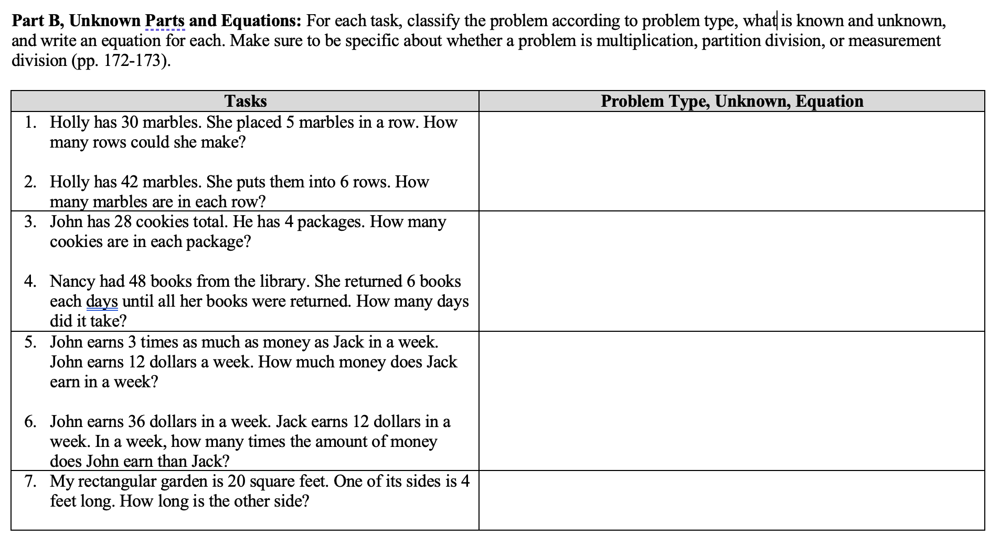

Slide 14
Multiplicative Structure Problems
Holly has 30 marbles. She placed 5 marbles in each row. How many rows could she make? Array, measurement division, __ x 5 = 30
Holly has 42 marbles. She puts them into 6 rows. How many marbles are in each row? Array, sharing division, 6 x __ = 42
John has 28 cookies total. He has 4 packages. How many cookies are in each package? Equal groups, sharing division, 4 x __ = 28
Nancy had 48 books from the library. She returned 6 books each days until all her books were returned. How many days did it take? Equal groups, measurement division, __ x 6 = 48
John earns 3 times as much as money as Jack in a week. John earns 12 dollars a week. How much money does Jack earn in a week? Comparison, sharing division, 3 x __ = 12,
John earns 36 dollars in a week. Jack earns 12 dollars in a week. In a week, how many times the amount of money does John earn than Jack? Comparison, measurement division, __ x 12 = 36
My rectangular garden is 20 square feet. One side is 4 feet long. How long is the other side? Area; unknown side length (group size or number of groups), __ x 4 = 20
Notes:
ANSWER KEY for Part B. Walk through each problem. Holly 30 marbles/5 per row: Array, measurement division, __ x 5 = 30. Holly 42 marbles/6 rows: Array, sharing division, 6 x __ = 42. John 28 cookies/4 packages: Equal groups, sharing, 4 x __ = 28. Nancy 48 books/6 per day: Equal groups, measurement, __ x 6 = 48. John 3x Jack/$12: Comparison, sharing, 3 x __ = 12. John $36/Jack $12: Comparison, measurement, __ x 12 = 36. Garden 20 sq ft/4 ft side: Area, unknown dimension, __ x 4 = 20.

Slide 15
Make Your Own Problem
Grab a piece of big post-it paper
Write three problems for your problem type, with all three of the possible unknown parts
Post your paper around the room
Solve ONE of the problems on a post-it that you did not write.

Slide 16
Until Next Time…
Week 10 Check-In due Friday @ 11:59pm
Lesson Plan 2 final and Lesson Plan 3 draft due Wed midnight, 10/29
Lesson Analysis Lesson 1 due Sunday 11/2
Read in VdW Ch. 9 (pages/sections in Canvas)
Notes:
Reminders: Week 10 Check-In due Friday 11:59pm. Lesson Plan 2 final and Lesson Plan 3 draft due Wednesday midnight. Lesson Analysis Lesson 1 due Sunday. Read VdW Ch. 9 sections on Canvas for next class.

Slide 17
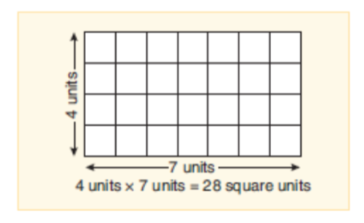
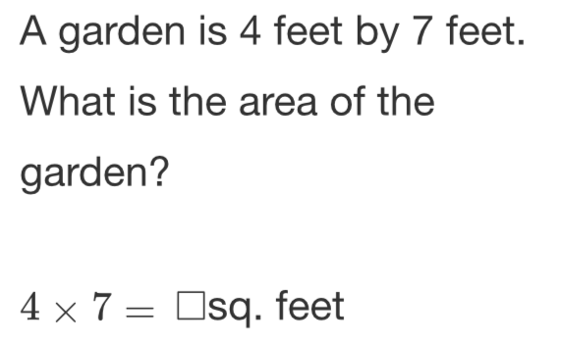
Area Problems
Notes:
Reference slide showing VdW diagrams and representations for Area problem type. Use during debrief if needed to show students the standard models.

Slide 18
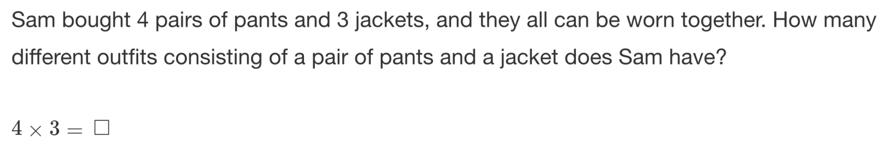
Combination Problems
Notes:
Reference slide showing VdW diagrams and representations for Combination problem type. Use during debrief if needed to show students the standard models.

Slide 19
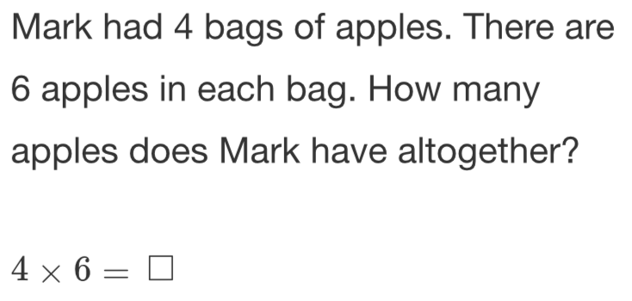
Equal-Group Problems
Product unknown: Multiplication
Group size unknown: Partition division (sharing)
Number of groups unknown: Measurement division
Notes:
Reference slide showing VdW diagrams and representations for Equal-Group problem type. Use during debrief if needed to show students the standard models.

Slide 20
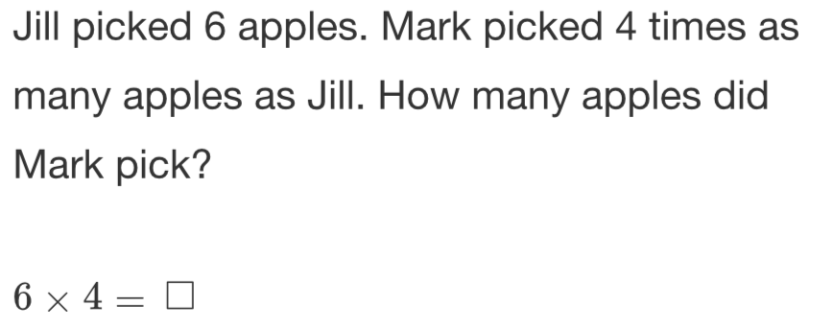
Comparison Problems
Product unknown: Multiplication
Group size unknown: Partition division (sharing)
Number of groups unknown: Measurement division
Notes:
Reference slide showing VdW diagrams and representations for Comparison problem type. Use during debrief if needed to show students the standard models.

Slide 21
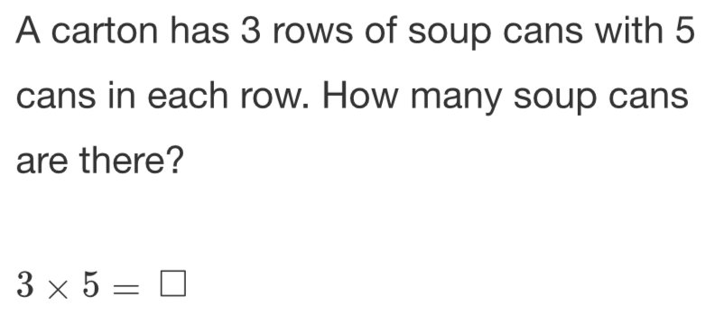
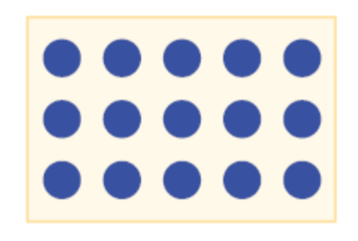
Array Problems
Product unknown: Multiplication
Group size unknown: Partition division (sharing)
Number of groups unknown: Measurement division
Notes:
Reference slide showing VdW diagrams and representations for Array problem type. Use during debrief if needed to show students the standard models.

Slide 22
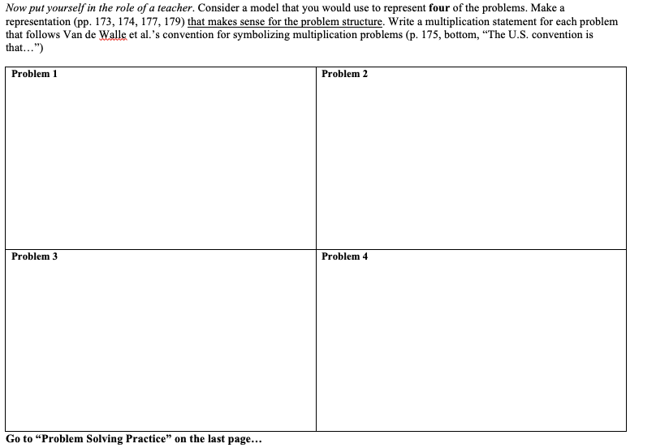

Slide 23
Multiplication Properties
Notes:
Properties of multiplication section. Time permitting only. Commutative property: arrays make it concrete (3 rows of 5 = 5 rows of 3). Associative property: grouping flexibility for mental math. Distributive property: foundational for multi-digit multiplication algorithms.

Slide 24
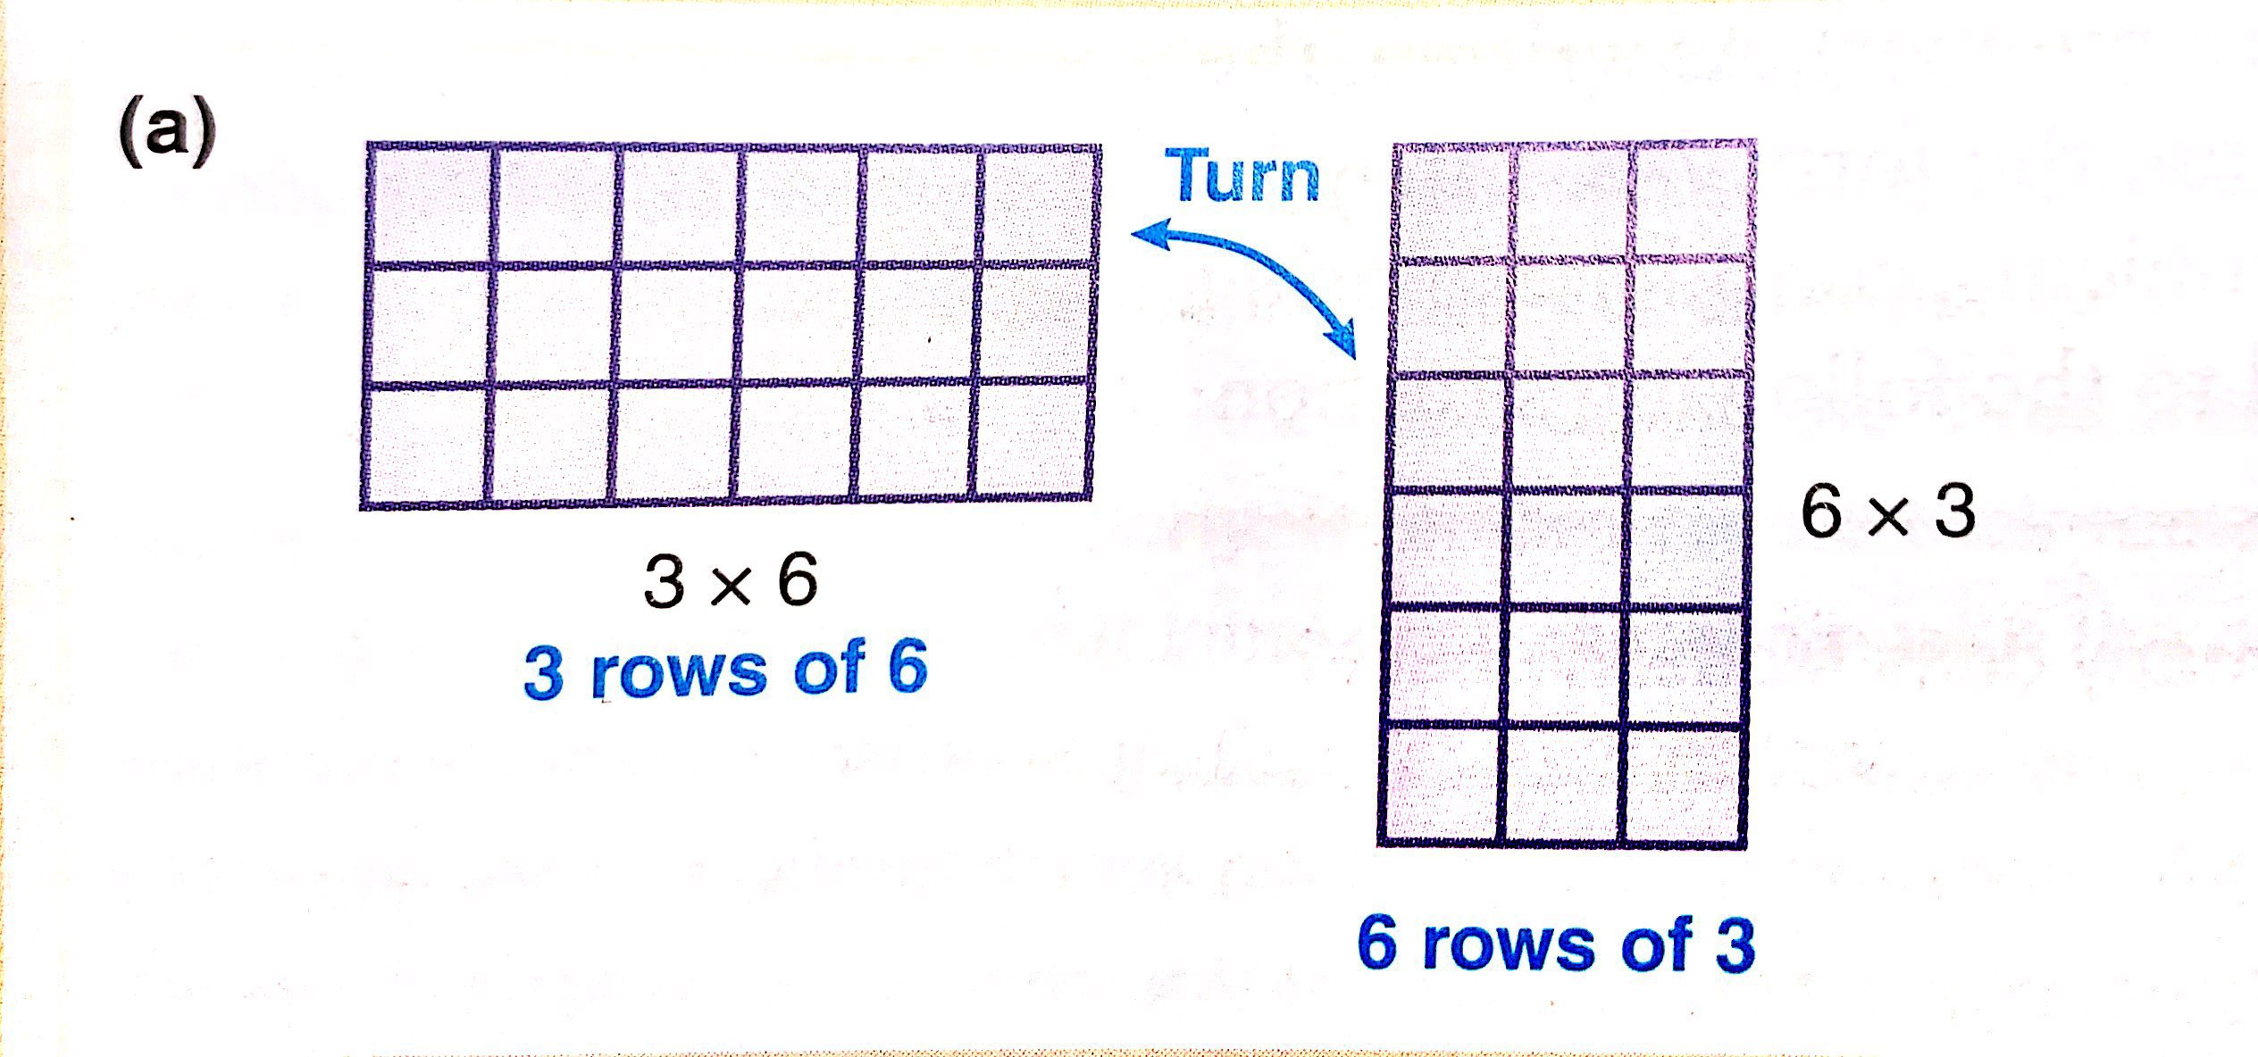
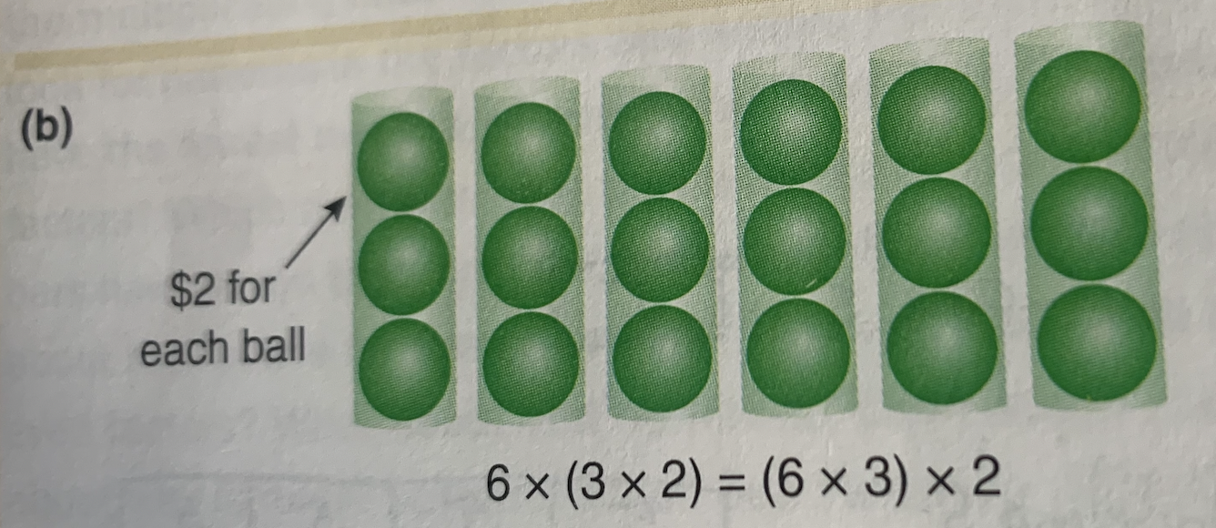
Commutativity and Associativity
Commutative Property
Associative Property
Notes:
Properties of multiplication section. Time permitting only. Commutative property: arrays make it concrete (3 rows of 5 = 5 rows of 3). Associative property: grouping flexibility for mental math. Distributive property: foundational for multi-digit multiplication algorithms.

Slide 25
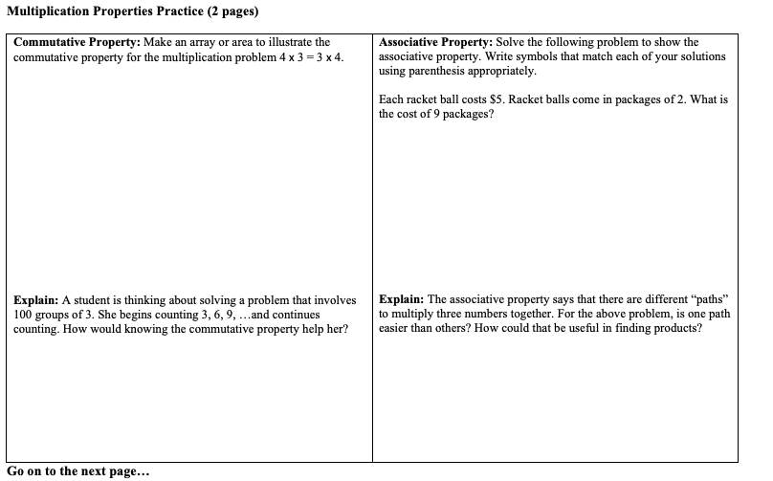

Slide 26
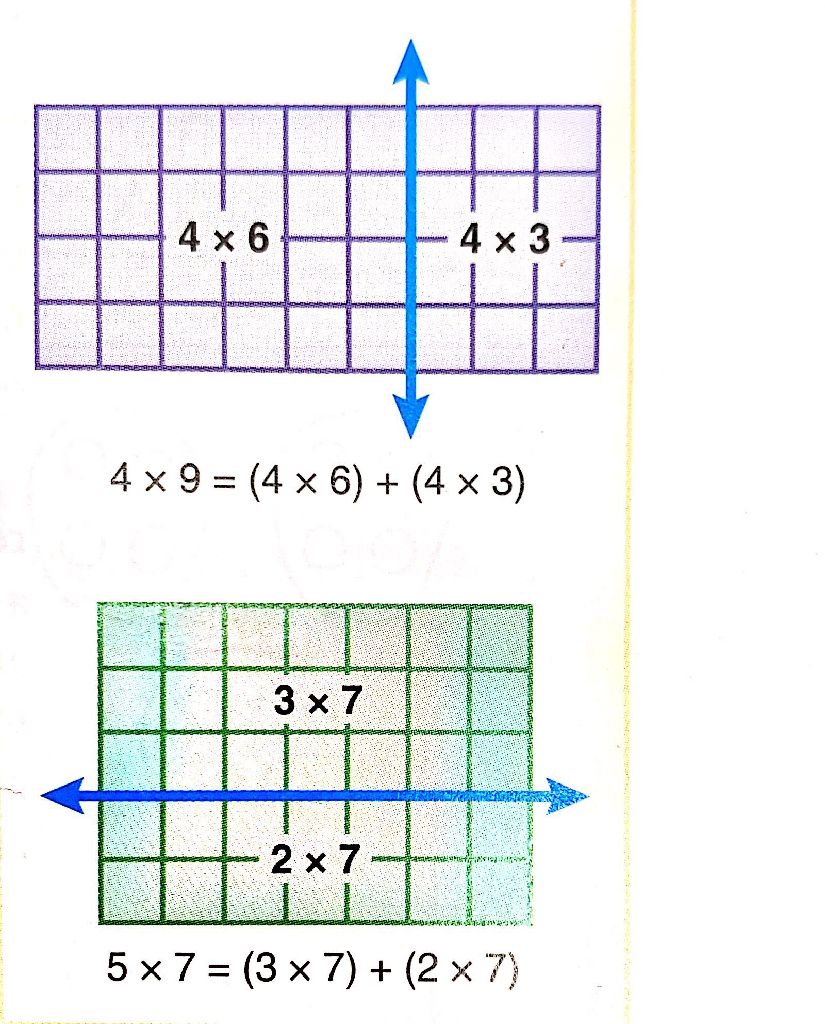
Distributive Property
Notes:
Properties of multiplication section. Time permitting only. Commutative property: arrays make it concrete (3 rows of 5 = 5 rows of 3). Associative property: grouping flexibility for mental math. Distributive property: foundational for multi-digit multiplication algorithms.

Slide 27
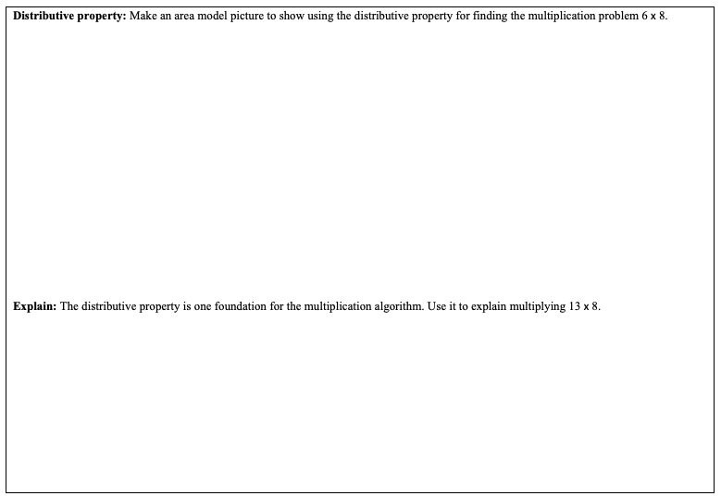

Slide 28
Problem Solving

Slide 29
VdW advocates for:
Thinking about the answer before solving the problem:
What is happening in this problem?
Is there any extra information we don’t need?
What will the answer tell us?
About how large or small will the answer be? Is that a large or small amount?
Let’s try the above:
The Marsal company had 165 widgets. The company bought 275 widgets wholesale for $3.69 each. In the first month, the company sold 205 widgets at $4.99 each. How much did the company make or lose on the widgets?

Slide 30
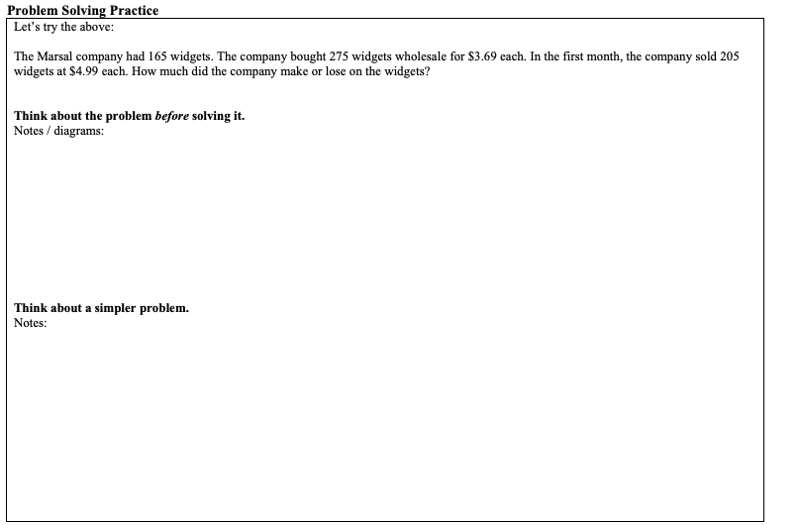

Slide 31
VdW advocates for:
Working a simpler problem:
Substitute small whole numbers for all relevant numbers in the problem.
Model (counters, drawings, numbers lines, bar diagrams, arrays) using the new numbers
Write an equation that solves the simpler version of the problem
Write the corresponding equation, substituting back the original numbers
Calculate
Write the answer is a complete sentence, and decide whether it makes sense
Let’s try the above:
The Marsal company had 165 widgets. The company bought 275 widgets wholesale for $3.69 each. In the first month, the company sold 205 widgets at $4.99 each. How much did the company make or lose on the widgets?
Notes:
Problem solving section. Time permitting only. VdW's two strategies: (1) Think about the answer before solving - what's happening, extra info, estimate. (2) Work a simpler problem - substitute small numbers, model, write equation, substitute back. Caution against key word strategies.

